Slide 1

The Boring Club in 2024 - 2025

Slide 2
New additions/tools
01
Engineering Launch
02
TABLE OF CONTENTS
Broad goals for the Club
03
Organization and Expectations
04
Volunteering and Fun Activities
05
RAIL, Discord bot, training modules?
Tabling, availability, goals
Financial, learning, connections, opportunities
What we expect from leaders in the club and members and how we will stay organized
Tied to section 3’s financial aspect, also what kind of fun team building activities can we host?

Slide 3
Bake Sale
Boeing Contest
Successes and Shortcomings in 2023 - 2024
RC Car
RSO Fair
Made a lot of profit and had a good turnout of volunteers, even met some people that were interested in our club
Although both teams got eliminated we got experience with what this process is like and what to expect in the future, more preparation is likely required
May not have had as much success as we would have liked to but we learned a lot about programming in Arduino IDE, schematic design, Onshape, and even a bit of power management
Had a good turnout and got many potential members contact info. MUST FOLLOW UP WITH ASAP, invite to see us at engr launch?
Notes:
AMEND THIS SLIDE WITH ACTUAL NUMBERS FOR BAKE SALE

Slide 4

New additions/tools
01
Our new RAIL, (Rolling Action Items List), Introductory Discord Bot, (In work), and potentially adding some new training modules as needed?

Slide 5
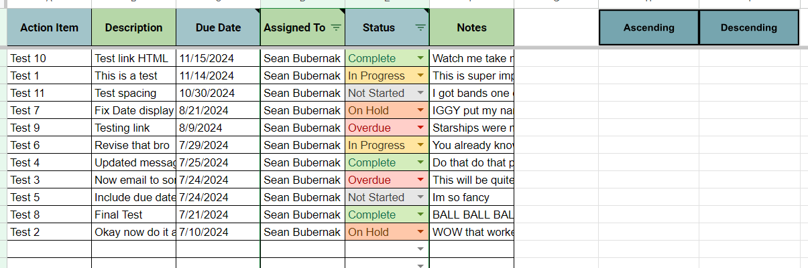
The Boring Club Rolling Action Item List
A place to assign tasks to anyone, can also be used by anyone, (not just leaders in the club)
When assigned that person will be sent an automated email describing the task to them and directing them to the Dashboard
This sheet can be filtered using the filters in the assigned to and status columns or sorted by due date using the ascending and descending buttons in the upper right
Notes:
Include Demo

Slide 6

The Boring Club Introductory Discord Bot
Josh is working on this currently, he will have it done by Sept 25th

Slide 7
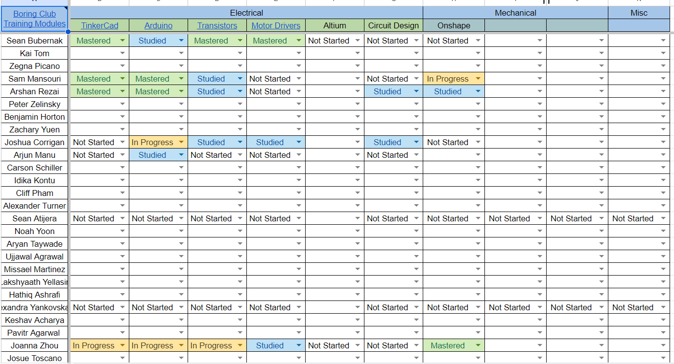
The Boring Club Training Modules
What are some skills we want to develop in our members?
Does everyone here know how to use the template to create new modules?
It is okay and encouraged for members to create their own modules as they see fit
Should we decide on what modules to add after deciding on this years major project, (will have another discussion to decide on that)

Slide 8

Engineering Launch
02

Slide 9

Overview
An opportunity to grow our club with new prospective members
Get noticed and be active as an engineering RSO
Practice for the future!

Slide 10

Logistics
RSVP
Date and Time
Venue/Map
Must RSVP with Lee Liao (lliao8@uw.edu), as she is coordinating the event. Can also email her any questions
September 24th, 2024
4:30 - 7 pm , (will need to get there earlier to set up)
HUB Ballroom

Slide 11
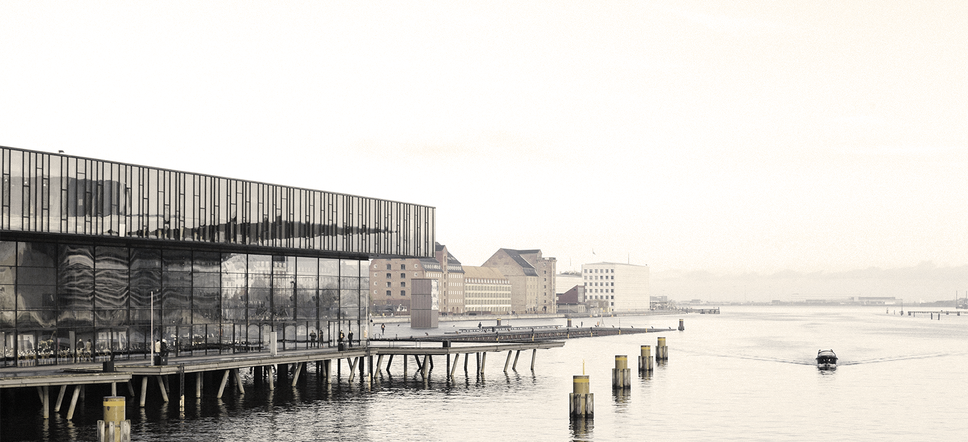

Sign up
Roles and Responsibilities
Roles
Whatever we used for the Bake Sale, follow up with people like a day before the event to confirm
Setup crew, greeters, presenters, cleanup crew?
Should we have people sign up for specific roles?

Slide 12

Engagement Strategies
Talking points, should prepare a script/bullet points to guide our discussion with prospective members
Interactive activities? Showcase past projects?
Sign up sheets and PRINTED QR code to sign up on

Slide 13

Goals for TBC
03
Financial, learning, connection, and other opportunities

Slide 14
$640
PROFIT LAST YEAR
1
FUNDRAISING EVENTS LAST YEAR
Financial History and Goals
What do we spend this on?
What do we want to earn this year?

Slide 15

Learning Goals
Add more training modules to spreadsheet?
Try to host one technical skills workshop per quarter, (ie: 3D printing, soldering, Linux Lab, etc.)
Resume/Portfolio building?

Slide 16

Organization and Expectations
What do we expect from our members and from ourselves as leaders in the club. How will we stay organized and achieve our goals?

Slide 17
Expectations
Members | Leaders
Be on time to all meetings | Be 10 mins early to all meetings
Check in with dashboard everytime you go to it | Never let your check in status be red, (two weeks)
Be reachable via discord or email | Be reachable via discord, email, or sms within one day
Be kind and respectful of other members | Seek to help others and improve the club
Come excited to learn | Take initiative, what can you add to the club?
Notes:
Leaders we expect a 3-5 hour per week commitment

Slide 18
Discord
Dashboard
File Repo
Organization
Leadership Meetings
Google Drive
Monthly Emails
Organizing members into teams they choose with specific privileges
Our google sheet where tasks can be assigned. Interests and skill levels can be seen and training modules are available
Our github repo for our projects, this is not yet done but their are plans to get this in motion
Potentially once a month? In person or zoom. Once a quarter would probably be fine as well we would just have a bit more to go over
We will probably still use this once our file repo is finished but it will become more obsolete
We could potentially send out emails each month to go over our itinerary for the month including what we got done last month

Slide 19

Open Discussion?

